Slide 1
The Function Design Recipe
CS 5010 Program Design Paradigms “Bootcamp”
Lesson 1.1
© Mitchell Wand, 2012-2017
This work is licensed under a Creative Commons Attribution-NonCommercial 4.0 International License.
TexPoint fonts used in EMF.
Read the TexPoint manual before you delete this box.: AAA

Slide 2
Module 01
Tools and Techniques
Object-Oriented Programming
Designing Data
Designing Functions
Designing Systems
Computing with Lists
Computing with Trees and Graphs
Designing with Invariants
Thinking about Efficiency
Interfaces and Classes
Inheritance
Objects with Mutable State
Efficiency, Part 2
Basic Principles
Computing with Higher-Order Functions

Slide 3
Learning Objectives
By the time you complete this lesson, you should be able to:
list the 6 steps of the Function Design Recipe
briefly explain what each step is.
explain the difference between information and data, and explain the role of representation and interpretation.

Slide 4
The function design recipe
The function design recipe is the most important thing in this course. It is the basis for everything we do.
It will give you a framework for attacking any programming problem, in any language. Indeed, students have reported that they have found it useful in other courses, and even in their everyday life.
With the recipe, you need never stare at an empty sheet of paper again.
Here it is:

Slide 5
The Function Design Recipe
The Function Design Recipe
1. Data Design
2. Contract and Purpose Statement
3. Examples and Tests
4. Design Strategy
5. Function Definition
6. Program Review
This is important. Write it down, in your own handwriting. Keep it with you at all times. Put it on your mirror. Put it under your pillow. I’m not kidding!
Notes:
Here is the function design recipe.

Slide 6
Brief Explanation of the Recipe
Data Design: what kind of data does your system deal with, and what does each possible value of the data mean?
Contract: what kinds of values does your function take as its arguments, and what kind of values does it return?
Purpose Statement: given a particular input, which value should the function return?
Examples/Tests: what is a typical call of your function? How can somebody tell whether your function is returning a correct value?
Strategy: how does your function compute the desired value? Describe the way it works in a tweet.
Function Definition: the code of the function.
Program Review: now that you have a working function, how can it or its explanation be improved to make it clearer to a reader?

Slide 7
A Function Designed According to the Recipe
Data Definitions: What real-world we are representing, and how they are represented.
;; DATA DEFINITIONS:
;; A FahrenTemp is represented as a Real.
;; A CelsiusTemp is represented as a Real.
;; f2c: FahrenTemp -> CelsiusTemp
;; GIVEN: a temperature in Fahrenheit,
;; RETURNS: the equivalent temperature in Celsius.
;; EXAMPLES:
;; (f2c 32) = 0
;; (f2c 212) = 100
;; DESIGN STRATEGY: Transcribe Formula
(define (f2c x)
(+ (* 5/9 x) -160/9))
;; TESTS
(begin-for-test
(check-equal? (f2c 32) 0
"32 Fahrenheit should be 0 Celsius")
(check-equal? (f2c 212) 100
"212 Fahrenheit should be 100 Celsius"))
Contract (or signature): what kinds of values the function takes as arguments, and what kind of value it returns
Purpose Statement: given a particular input, what is the value that the function should return?
Examples (for the reader)
Design Strategy: Brief description of how the function gets the answer.
Function Definition
Tests (executable)

Slide 8
The recipe is a recipe
It’s not just a list of components
It tells you the order in which you should do them.
Each step depends on the preceding ones.
If you do them out of order, you will get in trouble (trust me!)
In the rest of this lesson, we will discuss each step in turn.

Slide 9
Step 1: Information Analysis and Data Design
Information is what lives in the real world. To do this step, you need to do 3 things:
You need to decide what part of that information needs to be represented as data.
You need to decide how that information will be represented as data.
You need to document how to interpret the data as information.
Notes:
The first step is Information Analysis and Data Design.
To understand this step, we need to understand the difference between information and data. In this course, we use the word “information” to mean information about the real world. We use the word “data” to mean the way that information is represented in my computer program.
For example, right now I am wearing a red shirt. That’s information. I can represent that information by a string, say “rouge”. That’s data. (I chose “rouge” rather than “red” because my customer is French!).
In any application, we need to decide what part of all the information in the world needs to be represented as data, and exactly how it will be represented.
And we need to document that representation so that others can understand our program (remember, programs are meant to be read by people!)

Slide 10
The relation between information and data
representation
Information
Data
interpretation
stuff in the real world
bits in a computer
Notes:
Information is represented as Data
Data is interpreted as Information

Slide 11
Information and Data: Example
representation
My shirt is red
c = "rouge"
interpretation
How do we know that these are connected?
Answer: we have to write down the interpretation.
Notes:
Information is represented as Data
Data is interpreted as Information

Slide 12
Information and Data: Example
representation
My shirt is red
c = "rouge"
interpretation
Interpretation:
c = the color of my shirt, as a string, in French
This is part of the program design process.
Notes:
Information is represented as Data
Data is interpreted as Information

Slide 13
Deliverables for Step 1 (Information Analysis and Data Design)
Description of the real-world information to be represented.
Structure Definitions: declarations of new data structures if any.
Constructor Template: a recipe for building values of this data type.
Interpretation: what each value of the type represents.
Observer Template: a template for functions that look at values of this data type.
Examples (if needed so reader will understand).

Slide 14
That first step was a big one!
... but important: the vast majority of errors in student programs can be traced back to errors in step 1!
We’ll go through each of these steps in more detail in Lessons 1.3-1.5

Slide 15
Step 2: Contract and Purpose Statement
Contract: specifies the kind of input data and the kind of output data
Purpose Statement: A set of short noun phrases describing what the function is supposed to return. These are typically phrased in terms of information, not data.
The generally take the form GIVEN/RETURNS, where each of these keywords is followed by a short noun phrase.
When possible, they are phrased in terms of information, not data.

Slide 16
Examples of Contract and Purpose Statements
;; f2c: FahrenTemp -> CelsiusTemp
;; GIVEN: a temperature in Fahrenheit,
;; RETURNS: the equivalent temperature in Celsius
;; f2mars : FahrenTemp -> CelsiusTemp
;; GIVEN: Any temperature in Fahrenheit
;; RETURNS: The mean temperature on the
;; surface of Mars, in Celsius

Slide 17
Examples of Contract and Purpose Statements (2)
scene-with-cat : Cat Scene -> Scene
GIVEN: a Cat c and a Scene s
RETURNS: A Scene like s, except that the Cat c has been painted on it.
Of course there are no cats in our computer. What this means is:
c is the representation of some cat,
s is the representation of some scene,
and the function returns a representation of a scene like the one s represents, except the new scene contains an image of the cat.

Slide 18
Step 3: Examples and Tests
Examples: some sample arguments and results, to make clear to the reader what is intended.
;; (f2c 32) = 0
;; (f2c 212) = 100

Slide 19
Tests
Unlike examples, tests are meant to be executable. Your tests will live in the file with your code, so they will be run every time you load your file. That way if you inadvertently break something, you’ll find out about it quickly.
Our testing framework is based on rackunit and allows the tests to appear anywhere in the file; they are executed at the end of the file. You should try to put the tests near the function they test– see the example files.

Slide 20
Tests (2)
Here are the tests we wrote for f2c. Since we know that f2c must be a linear function, two tests suffice to guarantee that we got the constants right.
(begin-for-test
(check-equal? (f2c 32) 0
"32 Fahrenheit should be 0 Celsius")
(check-equal? (f2c 212) 100
"212 Fahrenheit should be 100 Celsius"))

Slide 21
Step 4: Design Strategy
A short description of how to get from the purpose statement to the function definition
We will have a menu of strategies.
We'll cover this in more detail in Module 2
Here is our starting list of strategies:
Design Strategies
1. Transcribe formula
2. Use template for <data def>
3. Divide into cases on <condition>
There will be more…

Slide 22
Design Strategy for f2c
For f2c, the strategy we used was “transcribe formula”
this is, we wrote down the mathematical function and transcribed into Racket.

Slide 23
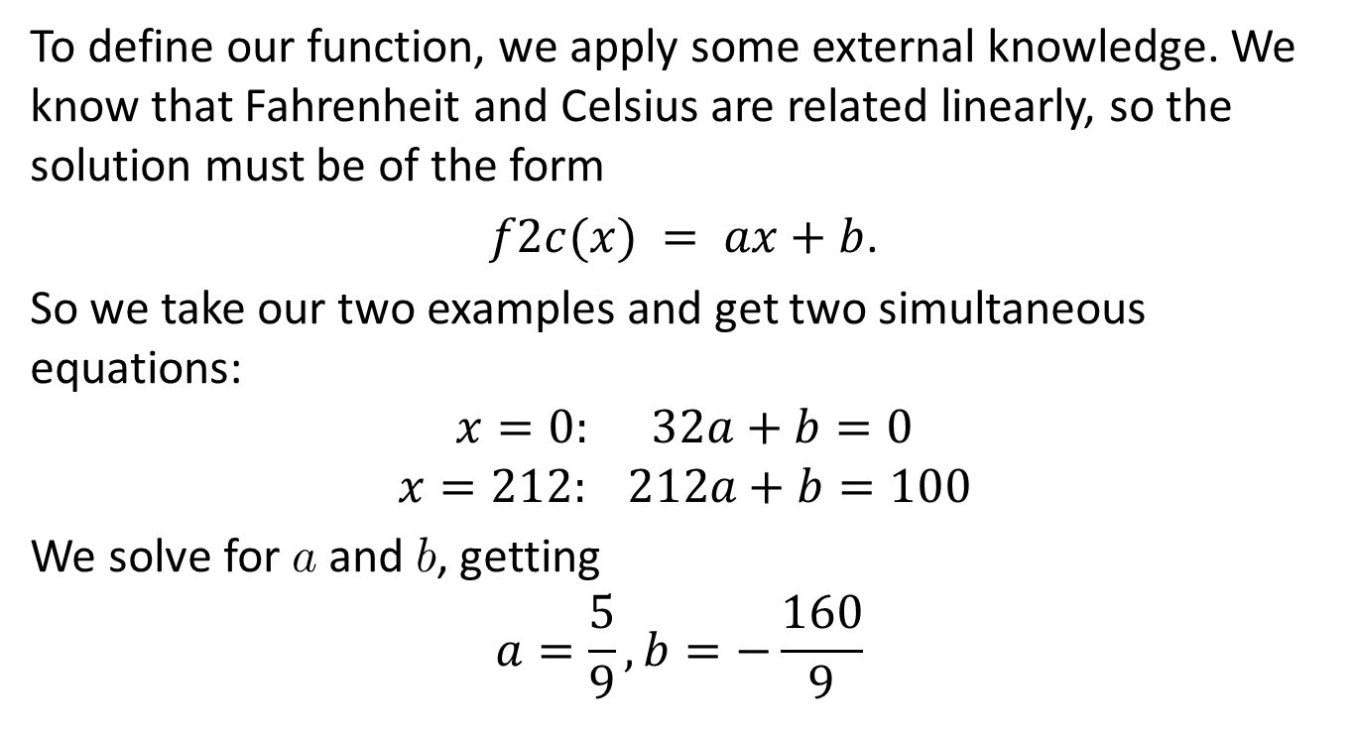
Step 5: Function Definition
To define our function, we apply some external knowledge. We know that Fahrenheit and Celsius are related linearly, so the solution must be of the form
$f2c(x) = ax+b$.
So we take our two examples and get two simultaneous equations:
$$x=0: 32a+b=0$$
$$x=212: 212a+b=100$$
We solve for a and b, getting
$$a=\frac{5}{9},b=−\frac{160}{9}$$

Slide 24
Function Definition
Now we can write the code.
Our code is just a transcription of the formula into Racket, using the fact that Racket has rational numbers.
(define (f2c x)
(+ (* 5/9 x) -160/9))

Slide 25
Step 6: Program Review
Did the tests pass?
Are the contracts accurate?
Are the purpose statements accurate?
Can the code be improved?

Slide 26
Summary
In this lesson, we have learned the steps of the Function Design Recipe.
6 steps
You need to do them in order.
The Design Recipe gives you a plan for attacking any programming problem
It is the single most important thing in this course!!

Slide 27
Next Steps
Review 01-1-f2c.rkt in the Examples folder.
Download and run it. Make some changes. What happens when you change the file? What kinds of error messages do you get?
If you have questions about this lesson, post them on Piazza.
Go on to the next lesson.

